Slide 1


Welcome to the Time Variance Authority!
Say hello to Miss Minutes.

Slide 2







PLAY YOUR PART, PRUNE PRODENTLY
SETTINGS
TIMELINE
ALBUM

Slide 3








GATORT TIMELINE
18 Deg
40% HMD
Asgard
Dec 19
2023

Slide 4


Asgard, 2023 12 12
HMD

Slide 5

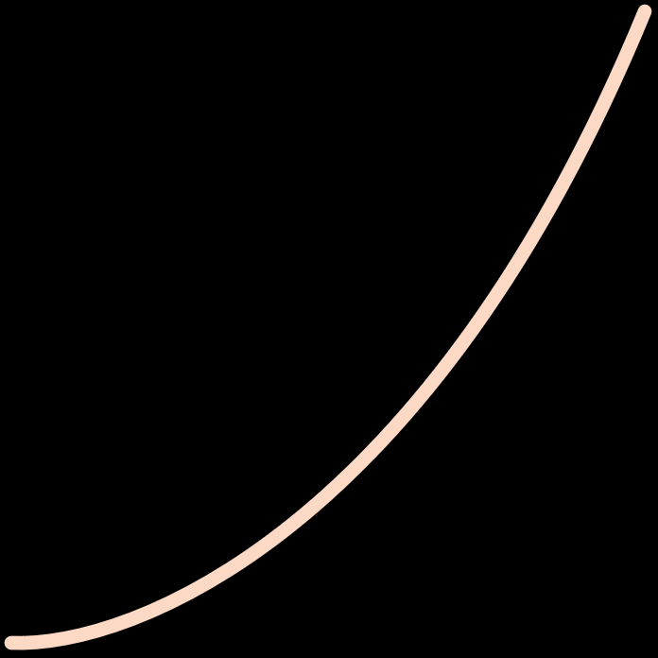
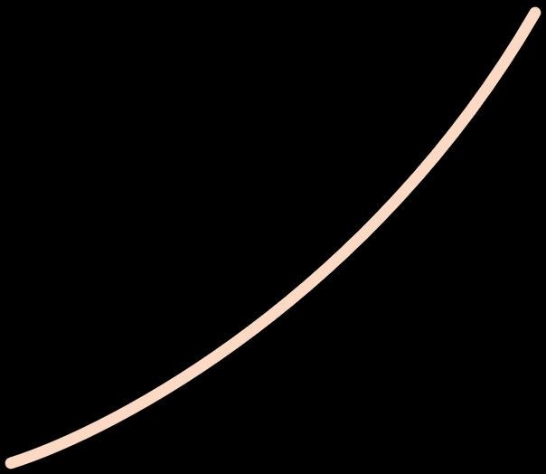
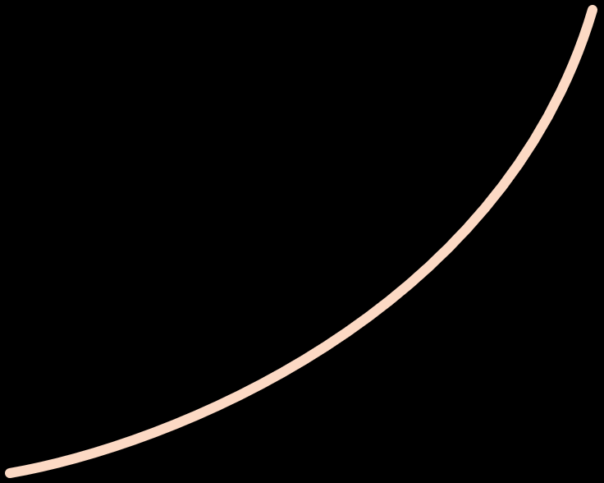




TIDY TIMELINE
HOUR:21
MIN:15
EVENT# | DATE | TIME | LOCATION | TEMP | HMD
46470152=027 | -08.03.1522 | 21:15:01 | Asgard | 25C | 40%

Slide 6

LOKI TIMELINE
18 Deg
40% HMD
Asgard
Dec 19
2023

Slide 7
MISS MINUTES REV00 TIMELINE
18 Deg
40% HMD
Asgard
12
Dec 19
2023
9
3
6

Slide 8















ALBUM

Slide 9
HRS
MINS

